Slide 1
ADAPTIVE COMPUTATION OFFLOADING USING MOBILE CLOUD COMPUTING
Project Guide : Mrs. D. Rajalakshmi M.E.,(Ph.D)
Team Members : Balaji C, RMDEC (CSE)
Ajay Arjun B Ka, RMDEC (CSE)
Aravindh Kumar R S, RMDEC (CSE)

Slide 2
ABSTRACT
The inherently limited resources of mobile phones hinder the possible execution of computationally intensive applications.
Offloading of computationally intensive application parts from the mobile platform into a remote cloud infrastructure or nearby idle computers addresses this problem.
Applications are developed by using the standard Android development pattern. The middleware does the heavy lifting of adaptive application partitioning, resource monitoring and computation offloading.
The evaluation shows that applications, which involve costly computations, can benefit from offloading with around 95% energy savings and significant performance gains compared to local execution only.

Slide 3
EXISTING SYSTEM
High computational application which cannot be effectively and solemnly run on the mobile within reasonable time and power are offloaded to the cloud for performing the computation and the result is pushed back into the mobile device which is displayed on the mobile device.
DISADVANTAGES
The offloading of the computation is not adaptive, the whole of the computation if offloaded for that specific application, which induces unnecessary overhead
This would lead to the requirement of persistent internet connection for the application to work, thus may lead to draining of battery rather than saving it.

Slide 4
PROPOSED SYSTEM
In the proposed system a framework or offloading engine is developed which will adaptively offload the parts of an application which are computationally intensive to the cloud.
It is adaptive in terms of deciding whether to offload the particular code fragment to the cloud or it is effective if executed locally. The framework performs the decision and then carries out the steps necessary to execute the particular function.
ADVANTAGES OF PROPOSED SYSTEM
This system enables high computation applications to be developed for mobile devices which are usually restricted by the battery power of the mobile devices.
The proposed system considerably reduces the execution times of complex algorithms by offloading them to the cloud thus saving computing cycles of the mobile platform.

Slide 5
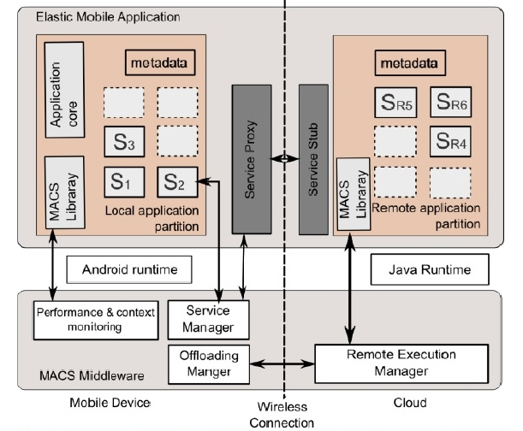
System Architecture

Slide 6
FLOW CHARTS

Slide 7
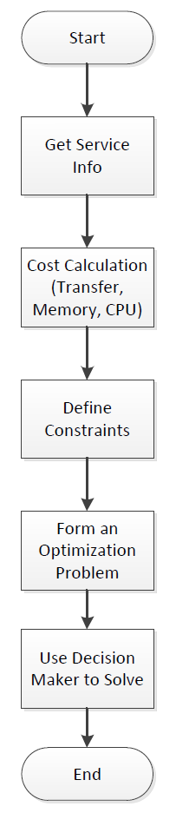
Allocation Determination

Slide 8
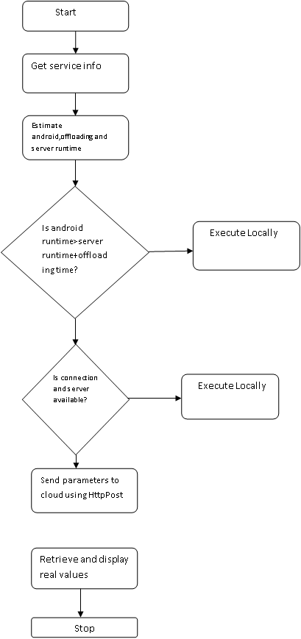
Offloader Working
no
yes
no
yes

Slide 9
Level 1 DFD
Load service info
Offloading
parameters
Offload
instructions
Cost parameters
User
Module
Virtual
Machine
Service info
Module
Decision
Module
Communication
Module
Local
Execution
parameters
Result

Slide 10
Modules
USER module(front end).
MIDDLEWARE (framework).
SERVER(cloud).

Slide 11

USER MODULE(front end)
The user module is a generic application developed using the standard android development procedure , it is run independent of the framework and other applications. The user module has no visibility of its lower layers which includes the framework and the cloud and runs as it would run in a normal environment . The user module can be any stand alone application which computationally intensive.
In our project we develop two sample applications which are computationally intensive and which are used for evaluating the results produced from adaptive offloading of the framework.
Frame
work
User module
launch
Service info

Slide 12
MIDDLEWARE (framework)
The middleware module acts as the interface between the android platform and the user module. The middleware is a framework which functions as a service on top of the android platform. The framework is divided into three sub modules:-
Service info module.
Decision module.
Communication module.
The service info module gathers the information about the user module(application) which includes code size , memory , execution parameters etc.
The decision module decides whether to offload the execution to the cloud or execute it locally based on parameters using formulae.
The communication module is responsible for transferring the data back and forth the cloud and the framework, it is responsible for the interaction between android platform.

Slide 13
User
module
Service
Info
Decision
module
Communication
module
cloud

Slide 14
3.SERVER(cloud)
The server contains an Android virtual machine which will be used by the cloud to provide platform as a service , the server will provide computational cycle to the android application. The middleware offloads the computationally intensive parts of the application to the cloud were the virtual machine processes it.
The virtual machine and the middleware perform transparently i.e. The user as no knowledge of the offloading process and application in the background and thus the workload of the mobile platform is reduced considerably and the idle cycles of the clouds are used.

Slide 15
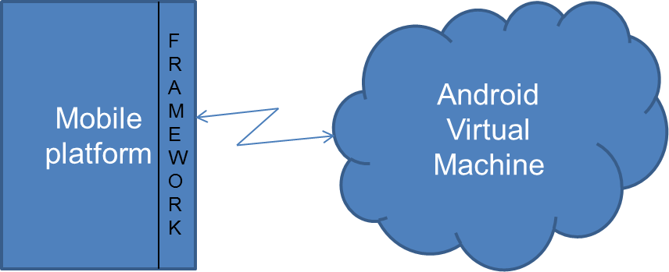

Slide 16
HARDWARE REQUIREMENTS
Hard Disk : 40GB and Above
RAM : 512MB and Above
Processor : Pentium III and Above
Mobile device : Dual core preferred
SOFTWARE REQUIREMENTS
Java 1.6 or higher is required.
Eclipse Indigo (Version 3.7.2) or higher is required.
ADT plugin for eclipse.
Amazon ec2 instance.

Slide 17
SCREENSHOTS

Slide 18
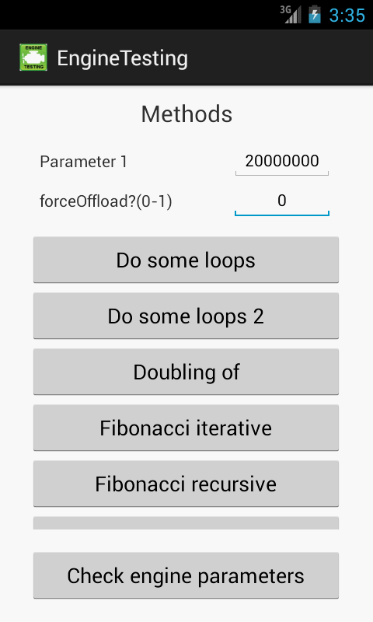

Slide 19
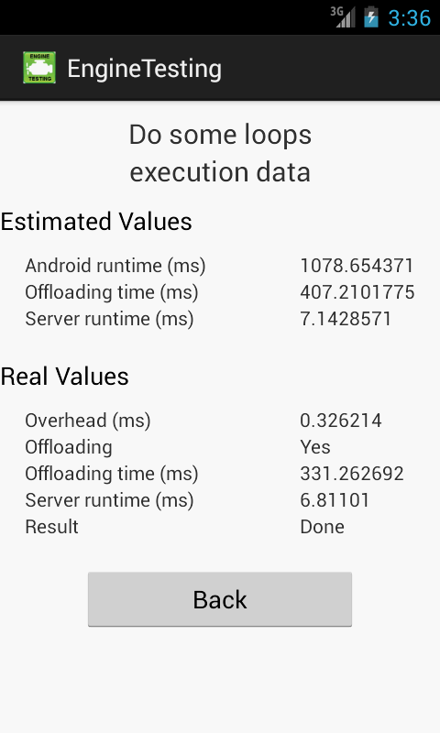

Slide 20
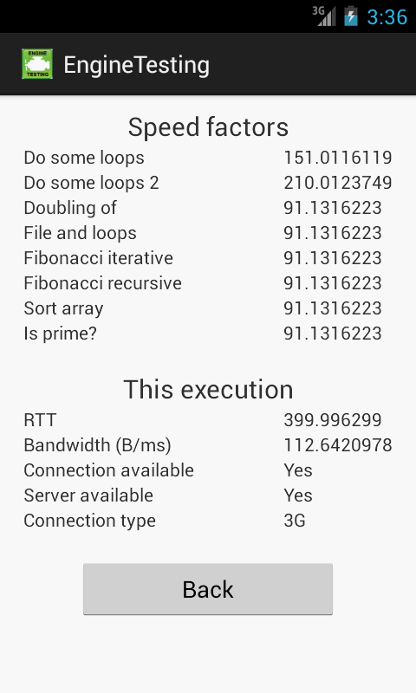

Slide 21
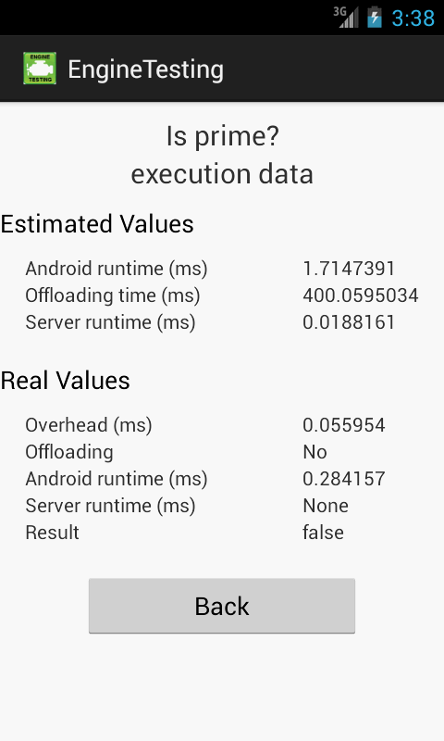

Slide 22
DO SOME LOOPS
n | Est.Androidrt(ms) | Est.Serverrt(ms) | Real Runtime(ms) | Offloadingtime (ms) | % saved(time) (ms)
20000000 | 143.13 | 7.14 | 126.4 | 573.75 | 11.68867463
40000000 | 281.48 | 28.3 | 227.63 | 580.89 | 19.13102174
60000000 | 412 | 40.42 | 353.54 | 588.03 | 14.18932039
80000000 | 540 | 56.07 | 447.143 | 595.18 | 17.19574074
100000000 | 664 | 70.24 | 74.23 | 602.32 | 88.82078313
200000000 | 1328 | 135.64 | 148.27 | 638.66 | 88.83509036
300000000 | 1992 | 189.14 | 222.75 | 673.76 | 88.81777108
600000000 | 3985 | 428.38 | 445.89 | 780.45 | 88.81079046
800000000 | 5314 | 634.33 | 592.84 | 852.33 | 88.84380881
1000000000 | 6590 | 707.45 | 741.56 | 645.92 | 88.74719272

Slide 24
Fibonacci Iterative
n | Est. Android rt(ms) | Est.Serverrt (ms) | Real runtime(ms) | Offloading time(ms) | % saved(time) (ms)
1000 | 0.02 | 8.57E-04 | 0.06 | 262.7 | -200
5000 | 0.06 | 0.002 | 0.061 | 262.7 | -1.666666667
10000 | 0.136 | 0.004 | 0.091 | 262.7 | 33.08823529
20000 | 0.272 | 0.008 | 0.152 | 262.7 | 44.11764706
80000 | 1.089 | 0.034 | 0.549 | 271.32 | 49.58677686
100000 | 1.36 | 0.042 | 0.64 | 279.6 | 52.94117647
20000000 | 272 | 8.57 | 11.08 | 288.533 | 95.92647059
40000000 | 544 | 17.63 | 17.57 | 297.1 | 96.77022059
60000000 | 817 | 25.71 | 21.83 | 305.67 | 97.32802938
80000000 | 1089.84 | 34.285 | 29.1 | 315.66 | 97.32988329
100000000 | 1362 | 42.85 | 36.358 | 345.39 | 97.33054332

Slide 25
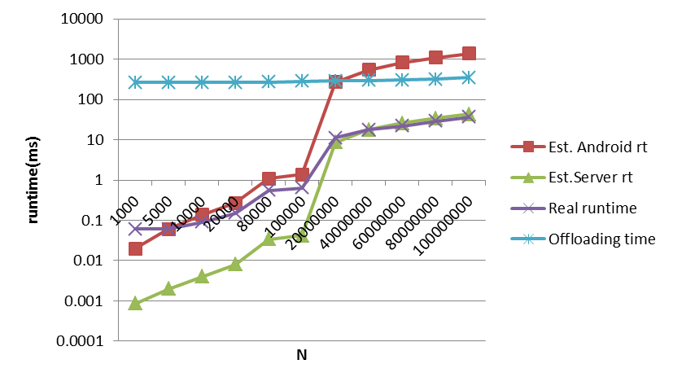

Slide 26
THANK YOU

